Slide 1
P04-TradeUp
M. Rayyan Khan M. Umar Zubair M. Shahmir Qazi
M. Ahmad M. Raiyaan Junaid Hamid

Slide 2
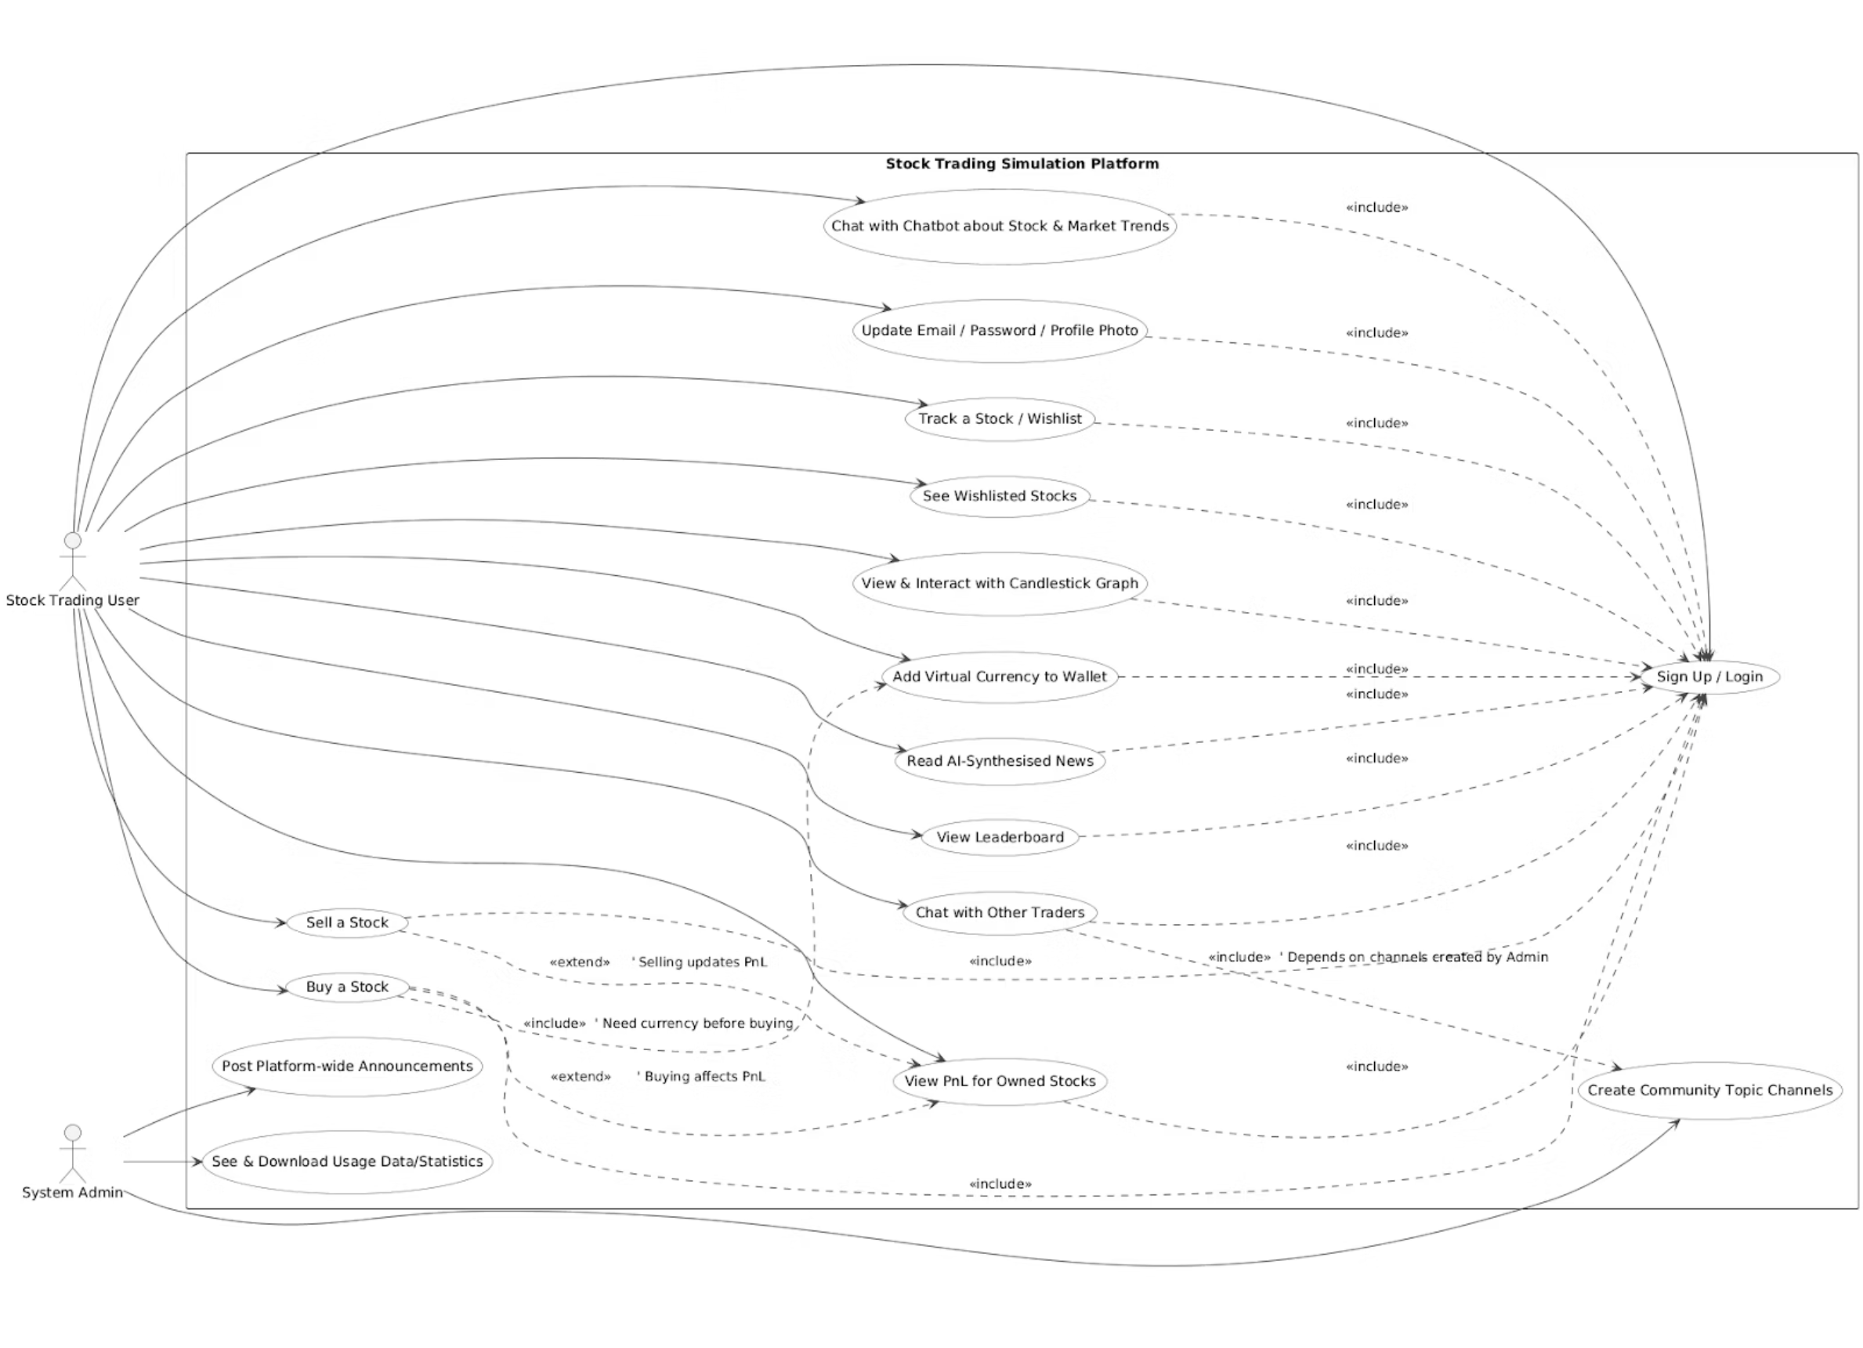
Use Case Diagram

Slide 3
Class Diagram
Link to diagram

Slide 4
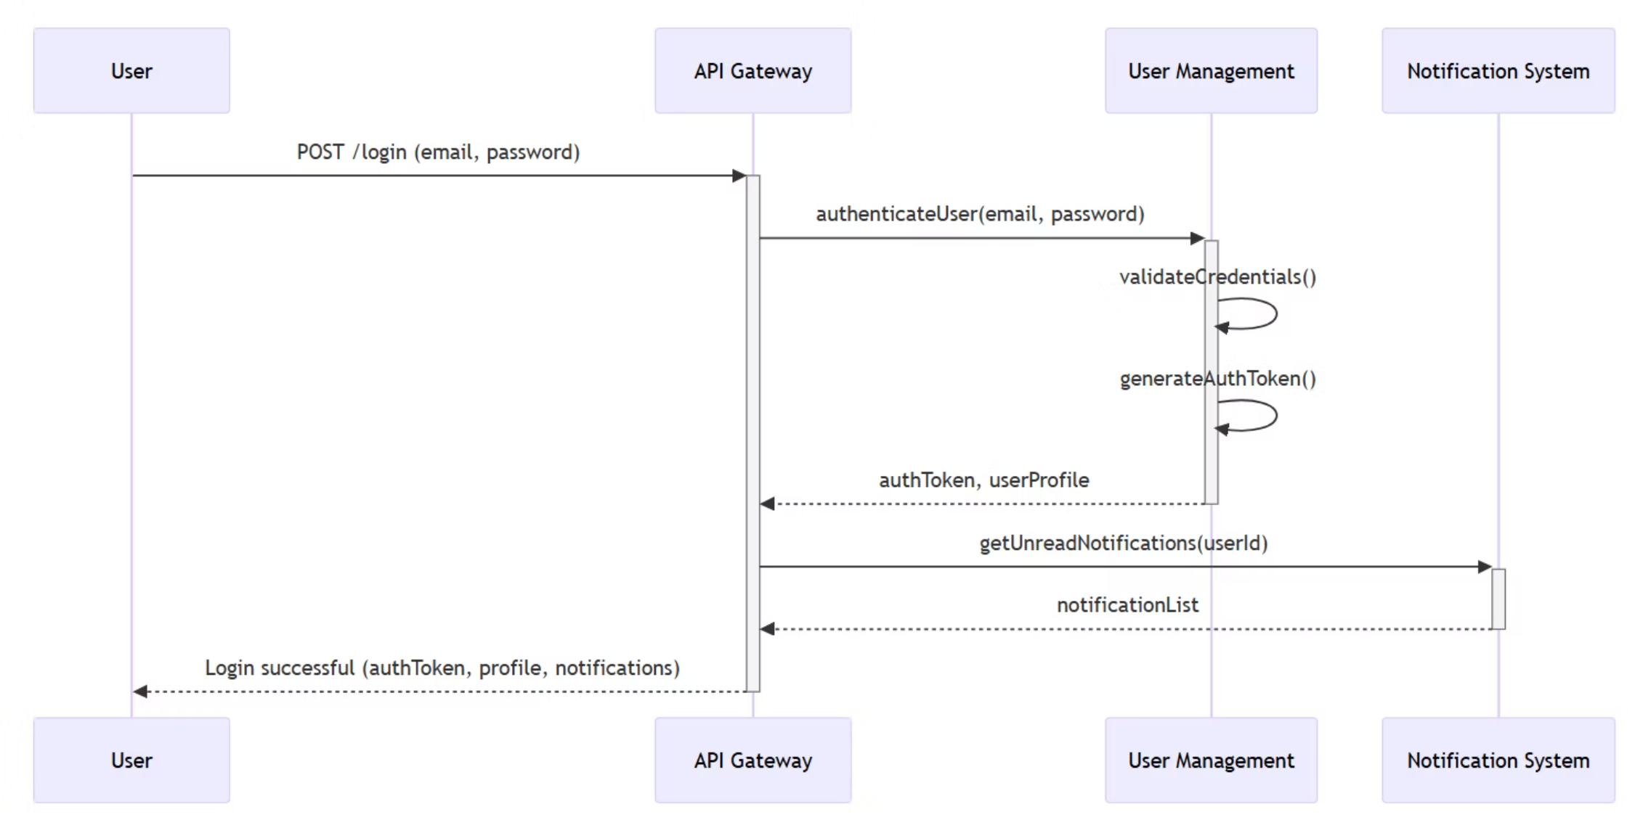
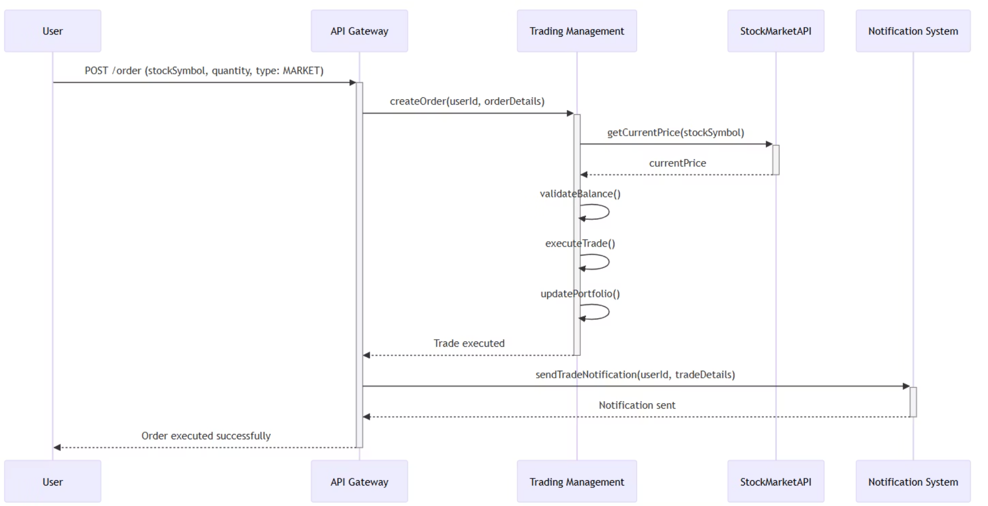
Sequence Diagrams
Place Market Order
User Login

Slide 5

Data Requirements Overview
Data Sources
Live Stock Market Data (PSXTerminal API)
Historical Stock Market Data (Kaggle Dataset: Pakistan Stock Exchange Data 2021-2024)
Data Volume Requirements
**Stocks Covered:** Aim for 200-500 listings.
**Minimum Size:** ≥ 250,000 labeled training examples (after 60-day lookback).
**Ideal Size:** Can achieve 1–3M raw daily rows and ≥ 1M training examples.
**History Rule:** Only train on symbols with ≥ 3 years of continuous data.
Target Label Options
1
Option A — Next-day Return (Regression)
"What % will this stock move tomorrow?"
Example: Close today = 100, tomorrow = 103 → return = +3%
2
Option B — Up/Down (Classification)
"Will the stock be up or down tomorrow?"
Label: 1 if return_{t+1} > 0, else 0
Simple, good for beginners; outputs probability of going up.

Slide 6

Data Fairness & Model Requirements
Data Fairness Requirements:
Sectors (types of business)
Ensure no single sector exceeds 25%; minimum 5% for real sectors.
Company size (market cap)
Include small, medium, and large companies, aiming for ~33% each.
Liquidity (trading volume)
Split stocks into 5 groups; each group must have at least 15% of samples.
Company age (since IPO)
Cover new (≤2 yrs), mid (2–5 yrs), and old (>5 yrs); aim for ≥10% each.
Market moods (volatility)
Include calm and volatile periods; ≥10% from the wildest 20% of days/stocks.
Delisted/renamed stocks
Retain these stocks; do not train only on survivors.
Model Requirements:
Training strategy:
Primary target: next-day return (regression)
Secondary target: Up/Down (classification)
Feature window: 60 trading days to predict next day (t+1)

